Slide 1

Six
facts
about
Open Web
and Firefox OS
budapest.mobile meetup
Budapest, Hungary
27. 10. 2014.
Kálmán Szalai „KAMI” ߦ Mozilla Rep ߦ kami911@gmail.com
@kami911kami ߦ linkedin.com/in/kami911

Slide 2
1
Open & Free

Slide 3

Web is the platform
All components are open and free
No walled gardens
You got mobile page already
One app for all
Notes:
Open and Free
The first word comes into my mind when I am thinking about Open Web and Firefox ecosystem including Firefox OS is openness. There aren't hidden secrets, walled gardens. We are a big family who develop new ideas and we are contributing to the common benefit of the Web. Please follow the standards and help us build a healthy Web together.

Slide 4

Hack Firefox OS's Gaia
https://github.com/mozilla-b2g/gaia
https://wiki.mozilla.org/B2G
Notes:
Open and Free
The first word comes into my mind when I am thinking about Open Web and Firefox ecosystem including Firefox OS is openness. There aren't hidden secrets, walled gardens. We are a big family who develop new ideas and we are contributing to the common benefit of the Web. Please follow the standards and help us build a healthy Web together.

Slide 5
2
Learn & Teach

Slide 6
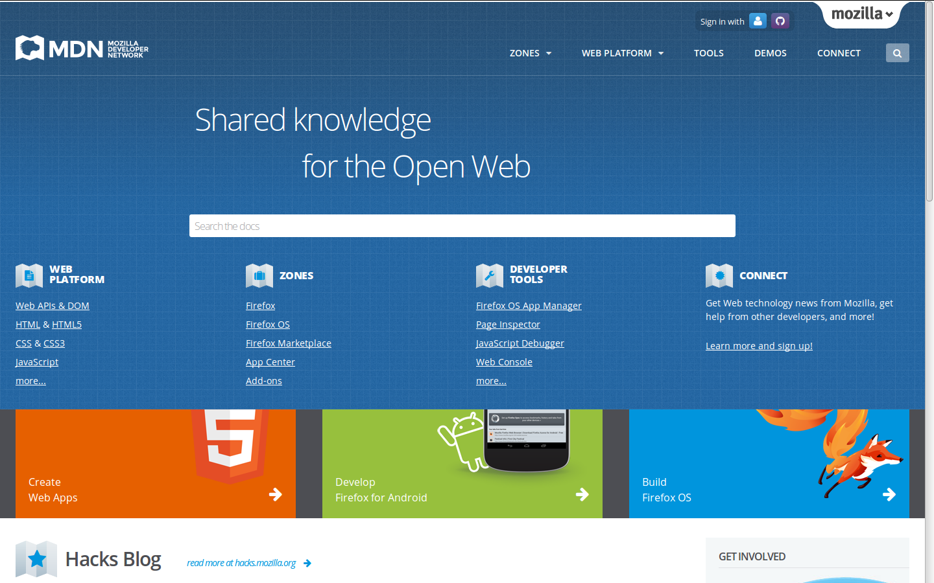
MDN
Mozilla Developer Network
https://developer.mozilla.org/

Slide 7
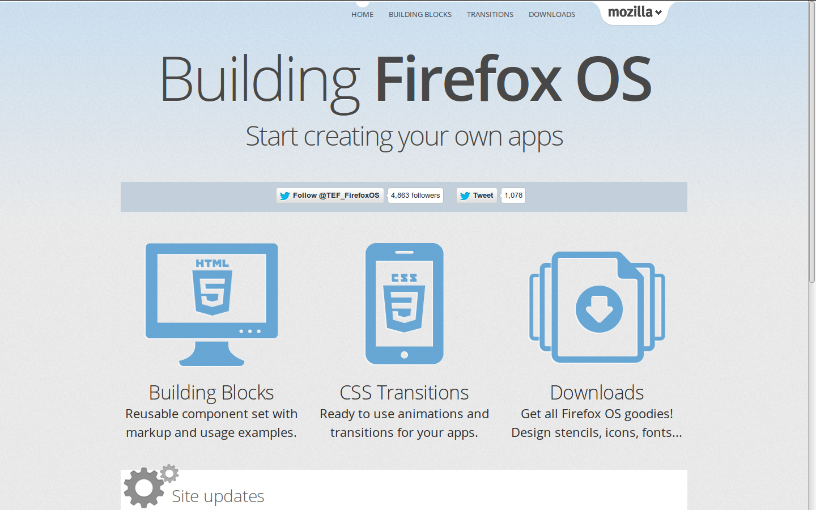
Blocks
Building Firefox OS
http://buildingfirefoxos.com/

Slide 8
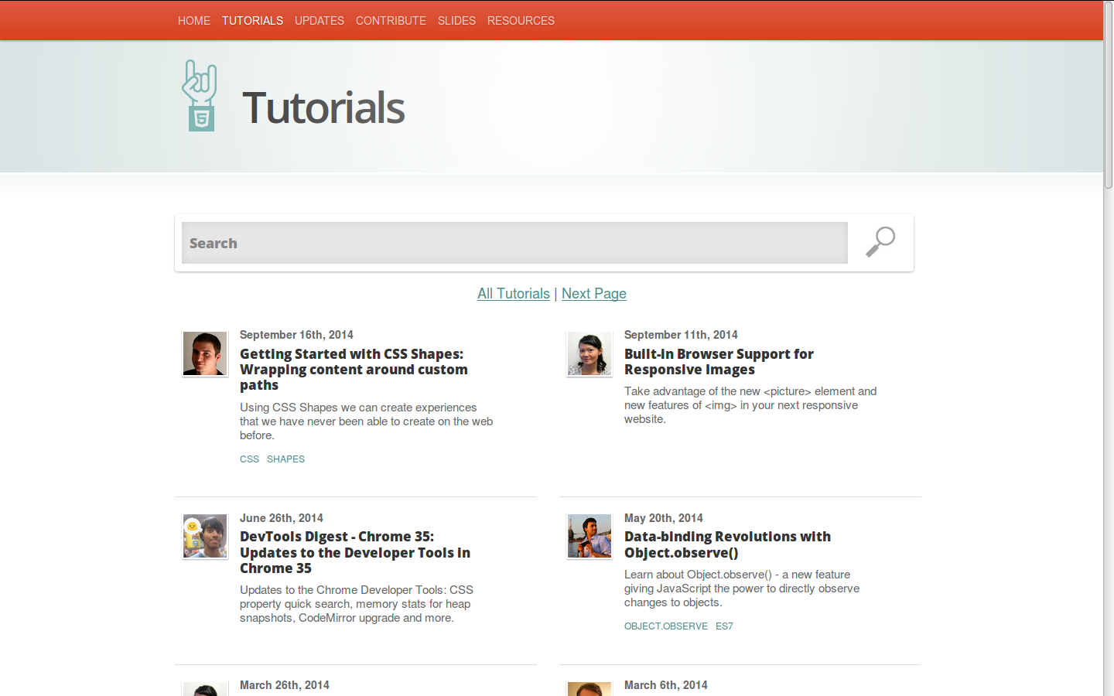
HTML5
HTML5 Rocks
http://www.html5rocks.com/en/

Slide 9
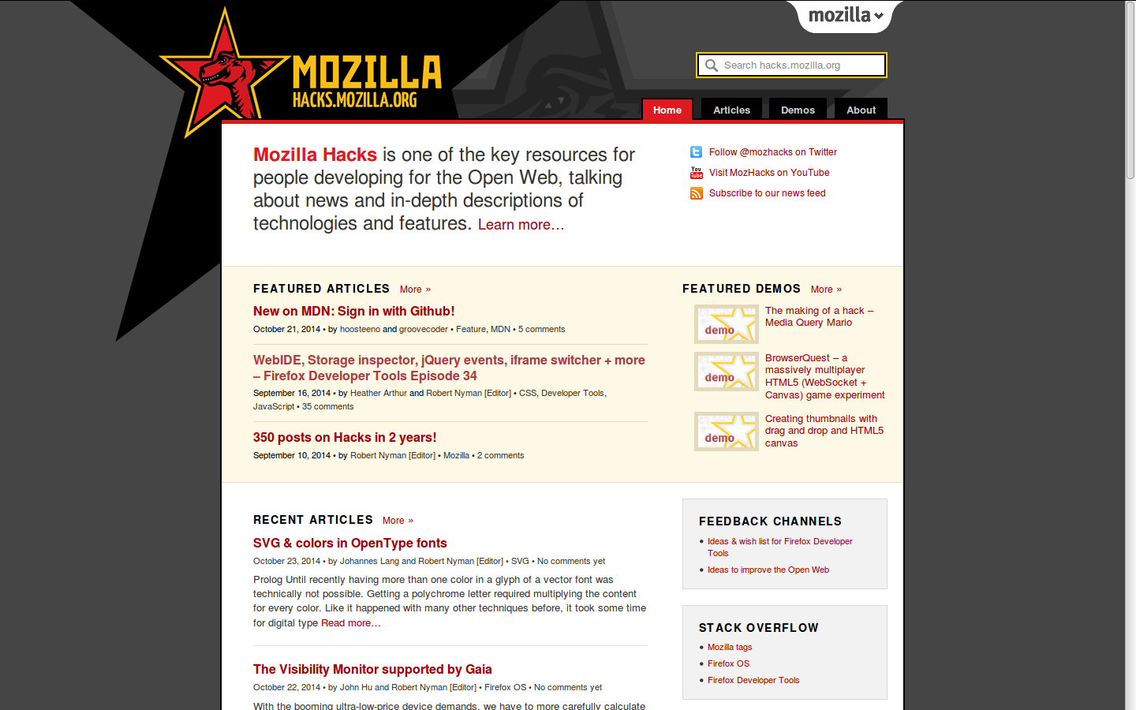
Hacks
Mozilla Hacks
https://hacks.mozilla.org/
https://www.youtube.com/user/mozhacks/playlists

Slide 10
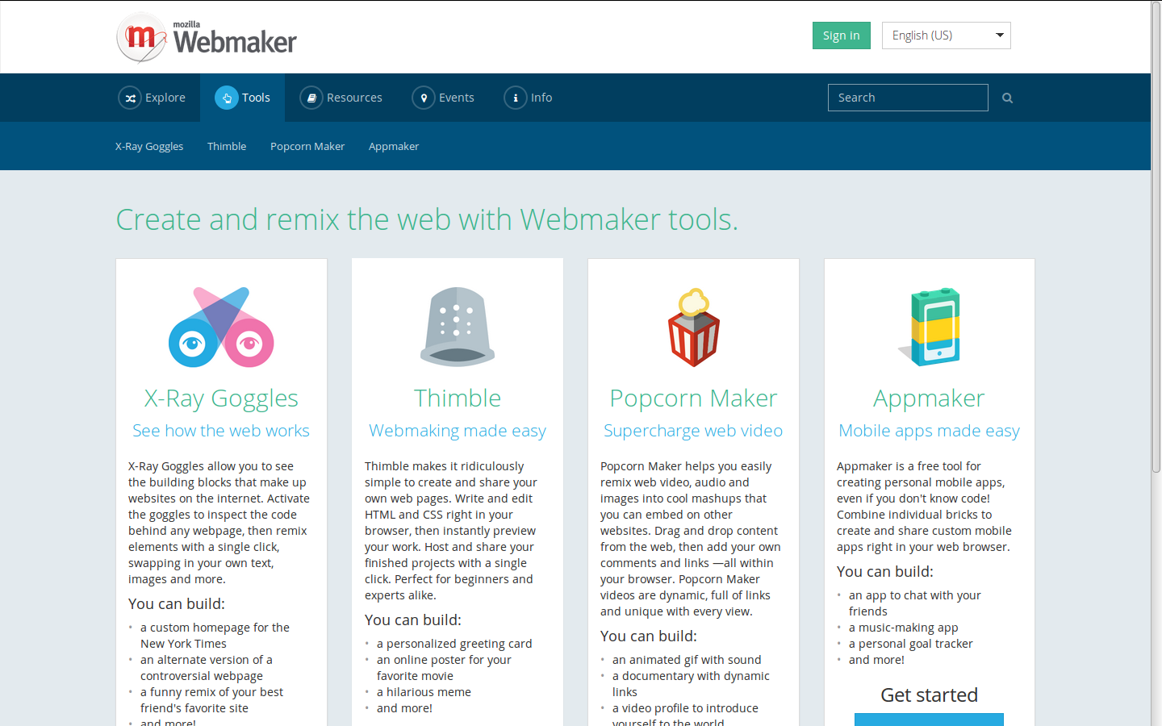
WebMaker
https://webmaker.org/

Slide 11
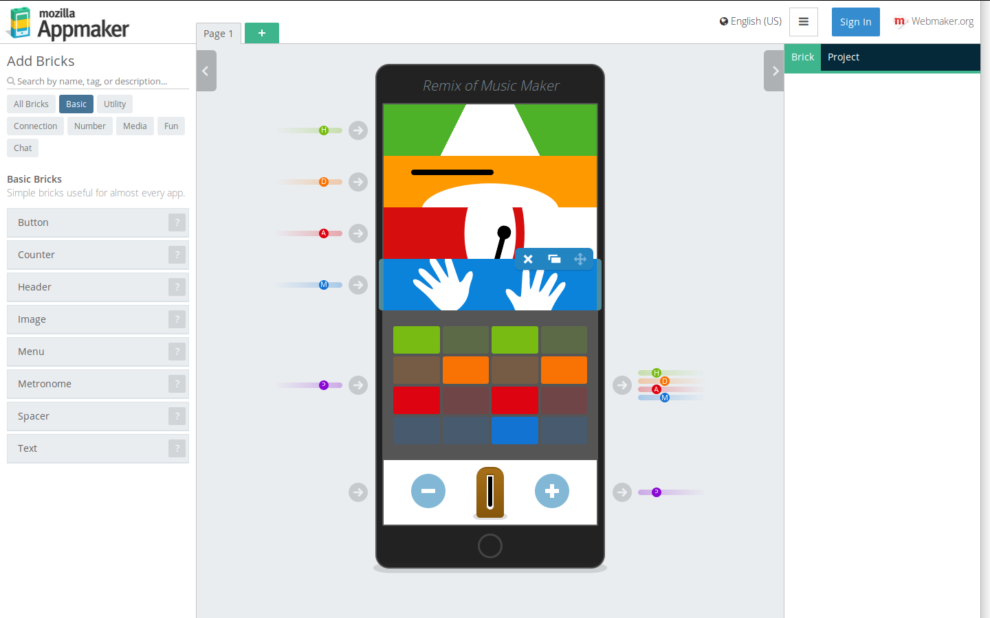
AppMaker
https://apps.webmaker.org/

Slide 12
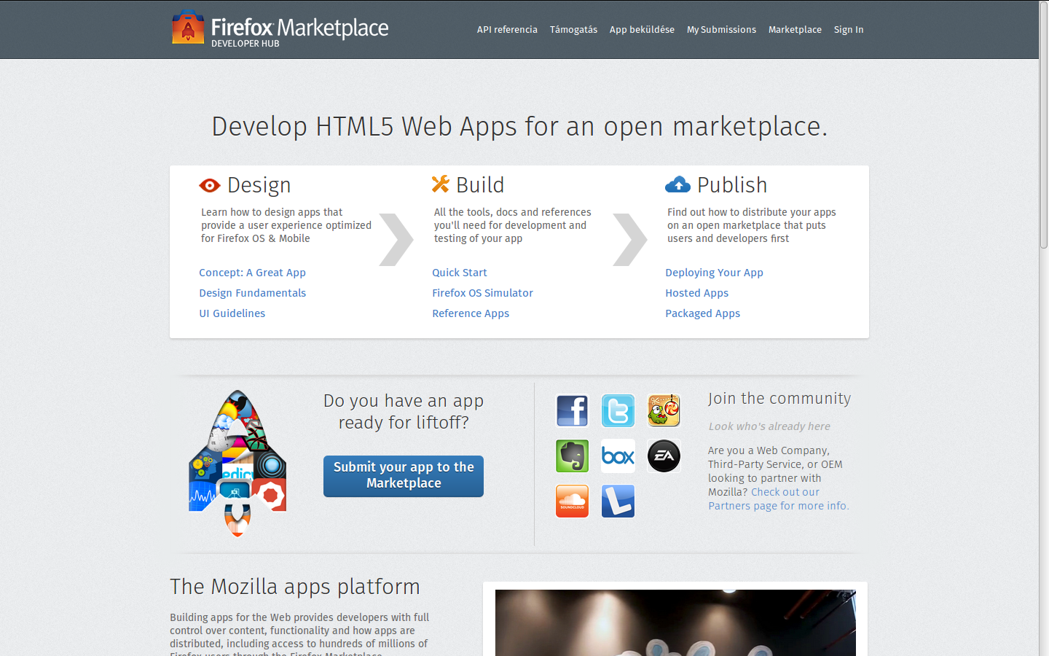
WebApps
https://marketplace.firefox.com/developers/

Slide 13
3
Tools & Dist

Slide 14
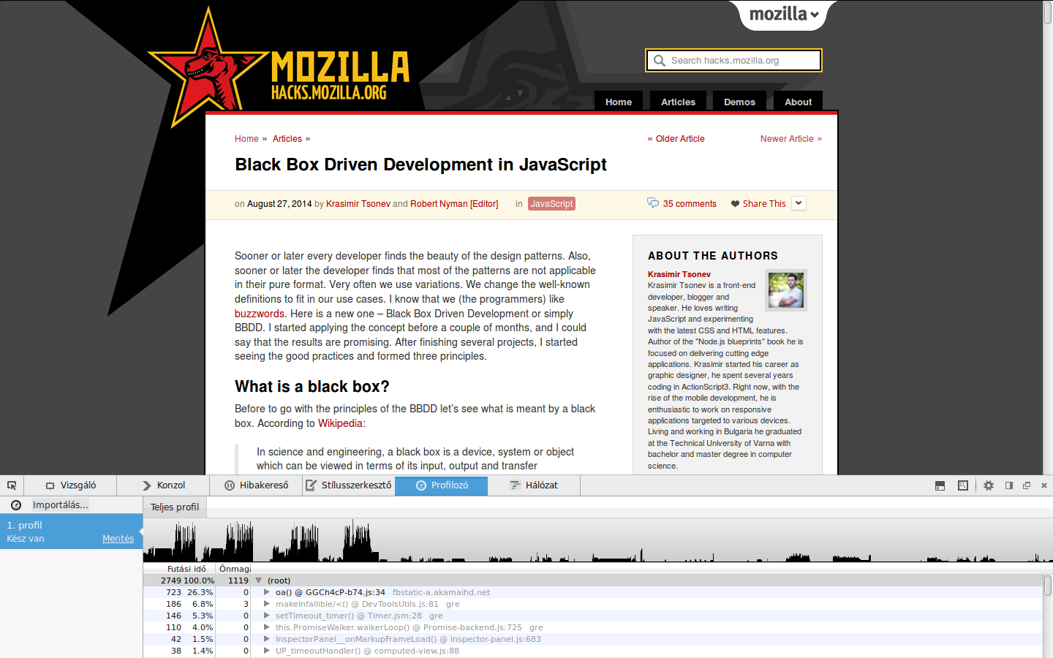
Webconsole

Slide 15
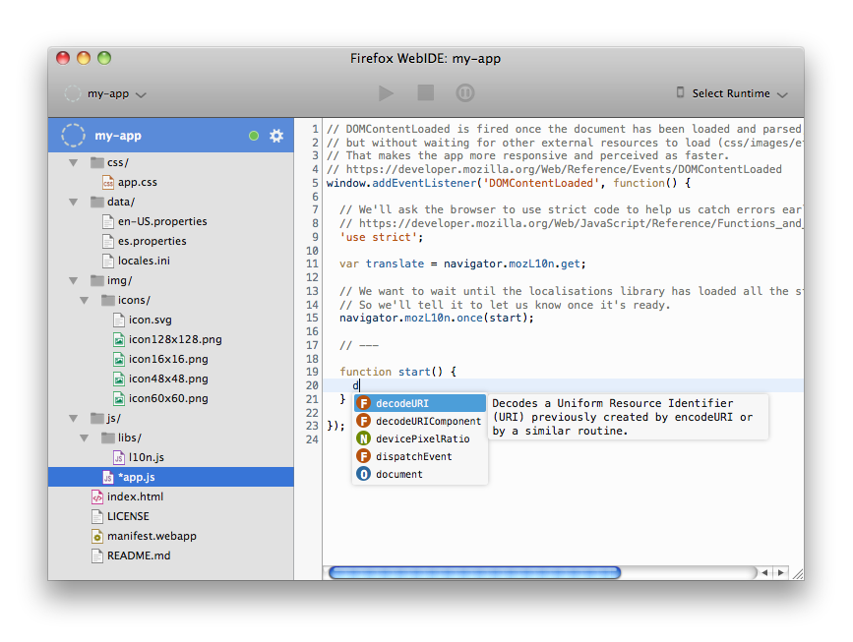
WebIDE

Slide 16
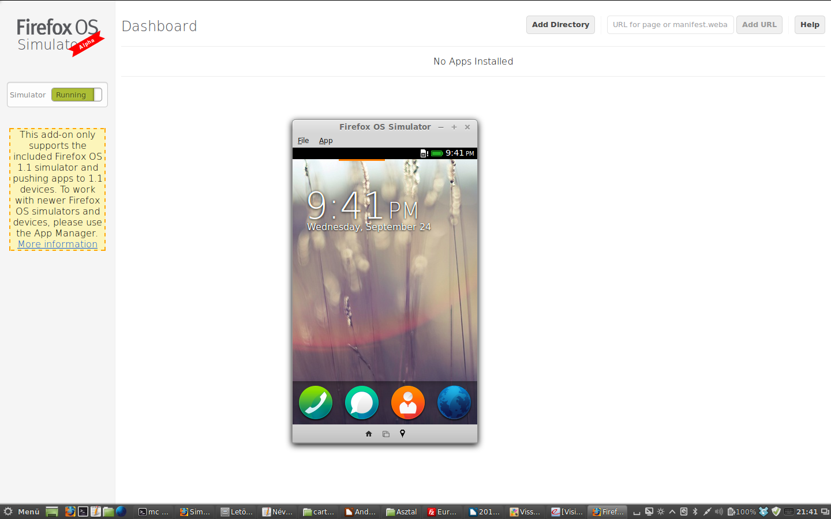
Firefox OS Simulator

Slide 17
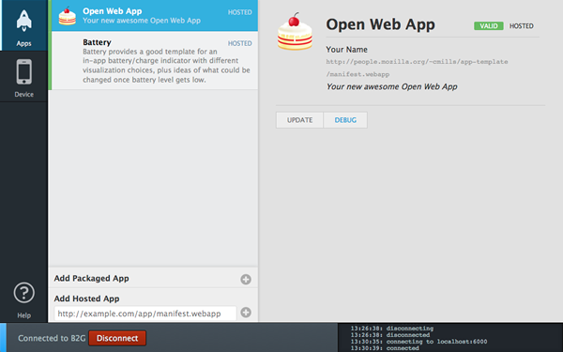
App Manager

Slide 18

Firefox Marketplace

Slide 19
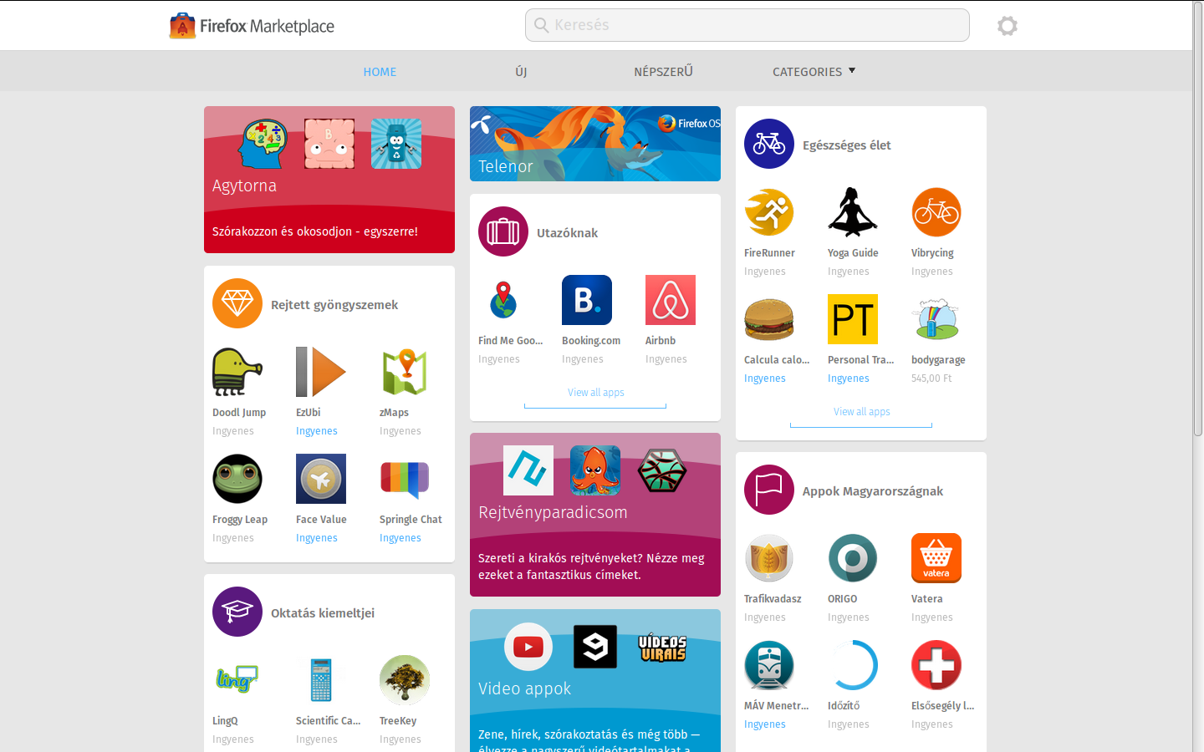

Slide 20
4
Native vs. HTML

Slide 21
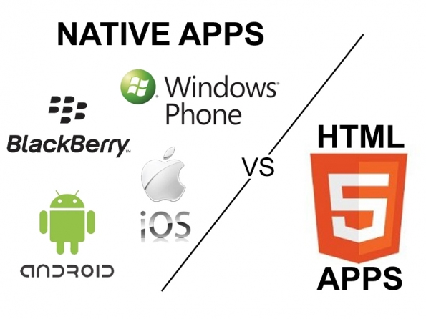

Slide 22
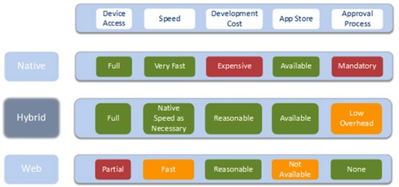

Slide 23

Webapps are
HTML 5
CSS 3
JavaScript
+
WebAPIs
+
Manifest file

Slide 24
Native apps vs. Webapps
W
E
B
A
N
D
R
O
I
D
I
O
S
W
P
W
E
B
O
L
D
A
L
M
O
B
I
L
W
E
B
W
E
B
A
P
P

Slide 25
5
WebAPIs & Co.

Slide 26

WebAPIs

Slide 27
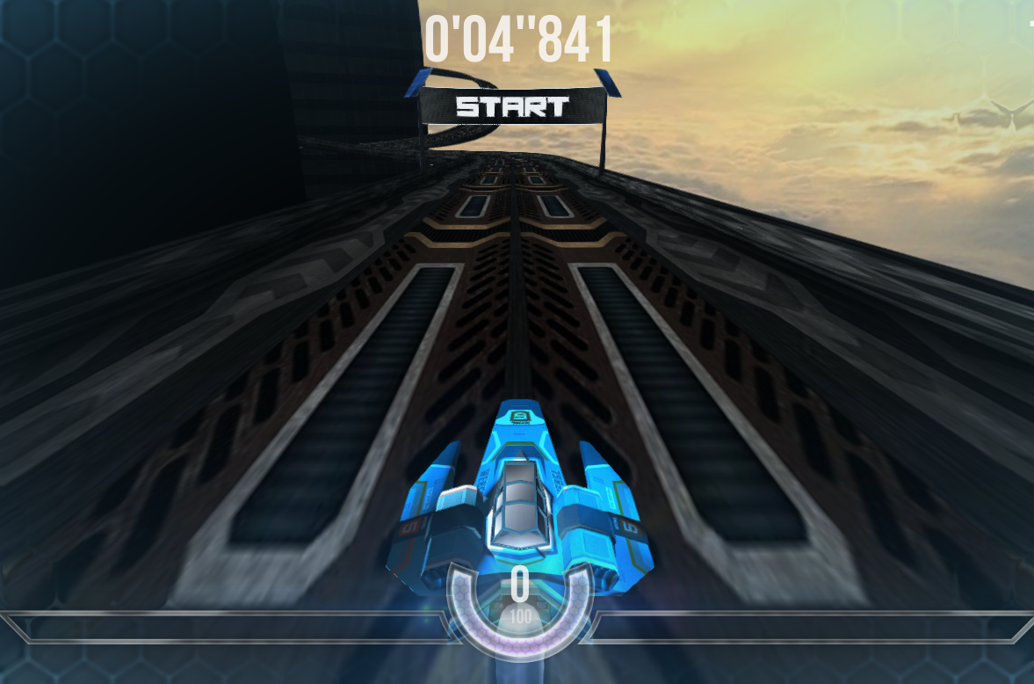
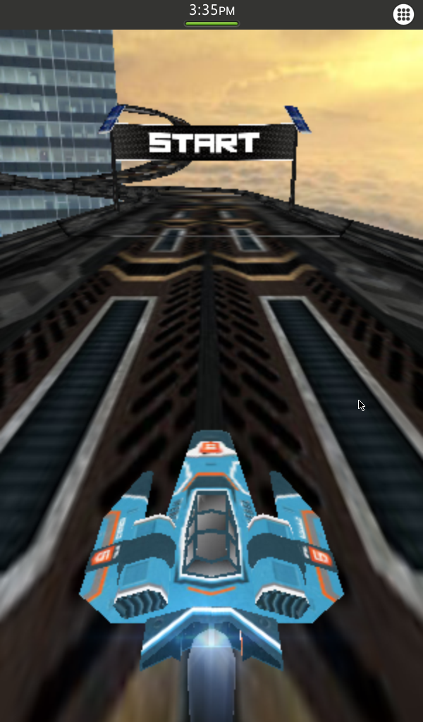
WebGL
Webconsole

Slide 28

WebRTC – http://www.webrtc.org/
Real time
  Audio
  Video
  Binary data
Firefox Hello
  Try it Now in Firefox Beta – https://www.mozilla.org/beta
  Final: 24. november 2014.

Slide 29
6
Platforms & Security

Slide 30
Type of WebApps
Firefox (desktop), Firefox OS, Firefox for Android → hosted web apps.
Firefox OS and Chrome (desktop) → packaged web apps
Cordova provides device adapters for many platforms, including Android, iOS and Firefox OS.
Hosted
  Web app
Packed
  Web app
  Privileged app
  Internal (Certified) apps

Slide 31
+1
Community

Slide 32
Mozilla Community in Hungary
Firefox OS
  https://www.facebook.com/fxos.hu
  https://www.mozilla.org/hu/firefox/os/
  https://plus.google.com/u/0/communities/103014232626387772793
Firefox & co.
  https://www.facebook.com/MozillaHU
  https://www.mozilla.org/hu/

Slide 33
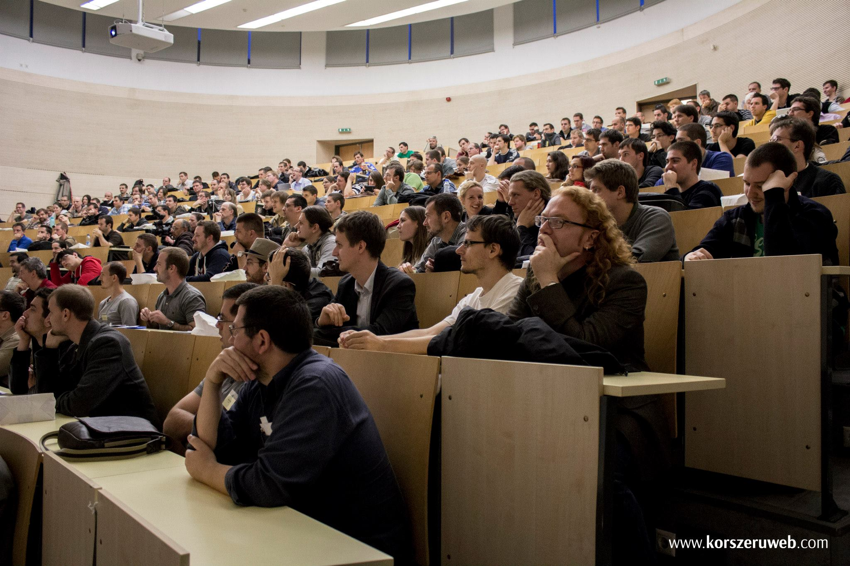
WebConf
Magyarországi Web Konferencia – 08. 11. 2014
http://webconf.hu/2014

